Slide 1
Approvals Functionality
Lalitha Balasubramhanya
Feb 15th 2013

Slide 2
Approvals - Overview
Clause-level approvals
System always checks for this first
Contract-level approvals
Once clause-level approvals are done; system checks for contract-level approvals

Slide 3
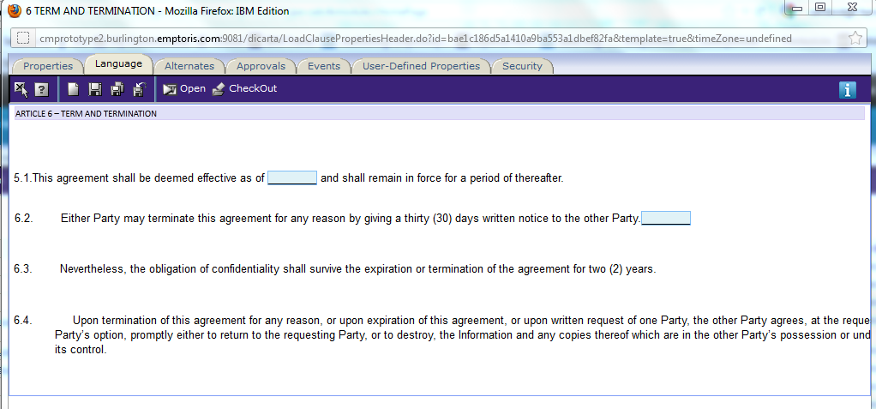
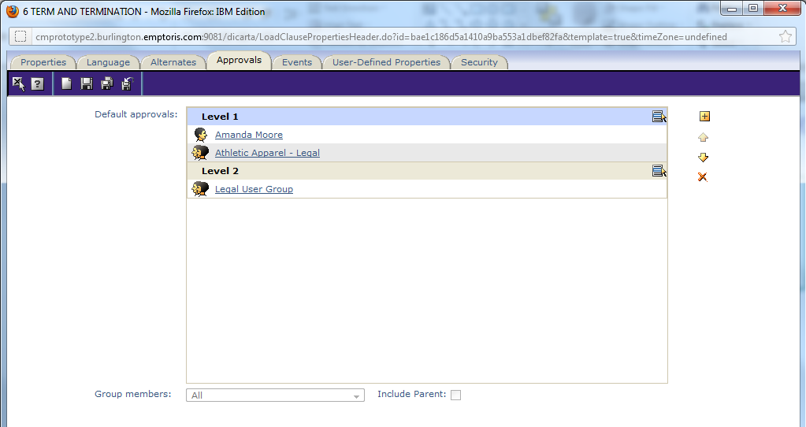
Clause-level Approvals – 1st Step
For a specific clause can trigger approvals when the clause text is modified. (Not triggered if a term embedded in the clause is modified.)
Each clause can have a distinct approval chain – set up for a clause template or clause instance. You can set this up only for important clauses.
Can set up sequential or parallel approvals
The approval status of each clause is tracked independently – separate email notifications
“is modified” from last approval is also tracked separate for each clause
Parallel - All users/user groups in a single level get task/notifications to approve at one time. Once everyone approves – moves to the next level; if anyone rejects sent back to the owner.
Only one user from a user group needs to approve.
Sequential – Once all approvers in Level1 approve, moves to approvers in Level2

Slide 4
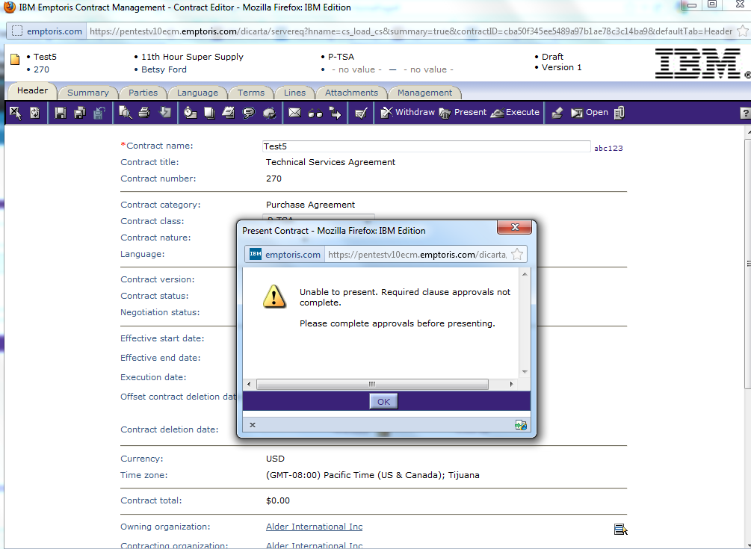
Initiating Clause-level Approvals User clicks on Present/Execute

Slide 5
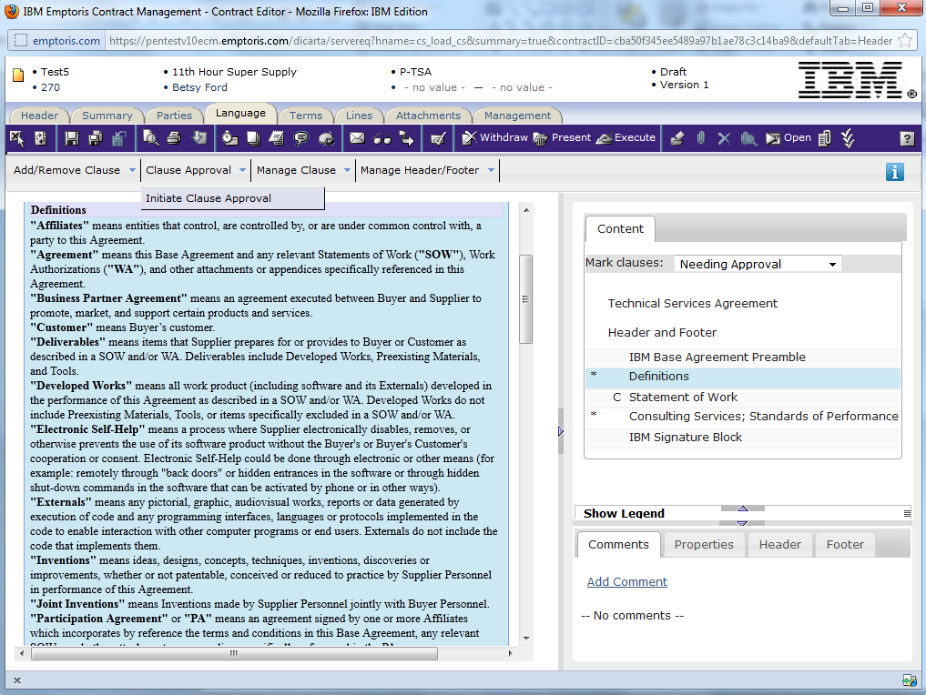
Initiating clause-level approvals User selects a clause – initiates approvals

Slide 6
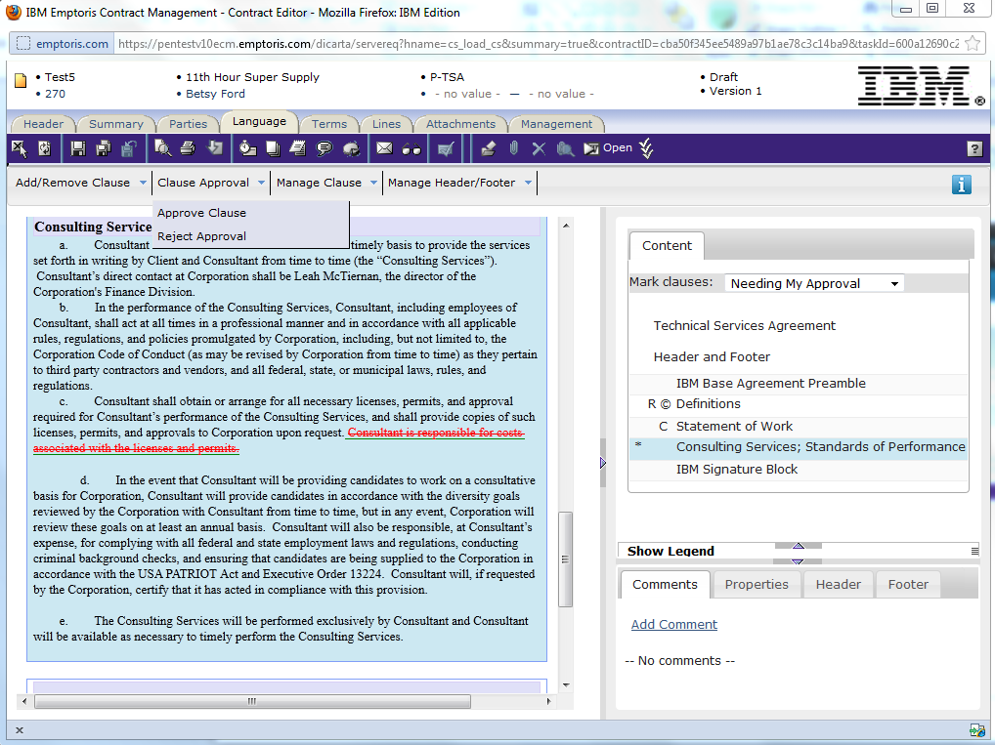
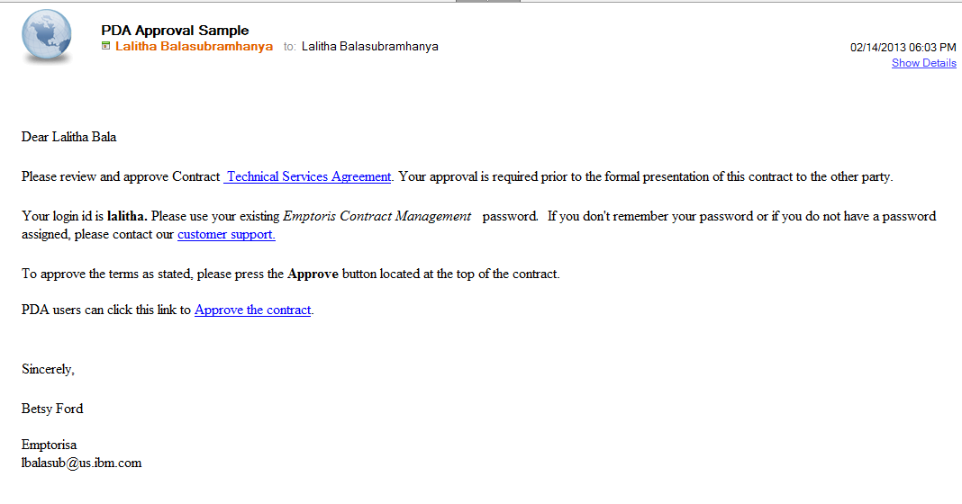
Option 1 – approver opens contract to approve clauses
Can include entire contract document and contract summary as attachments to the email

Slide 7
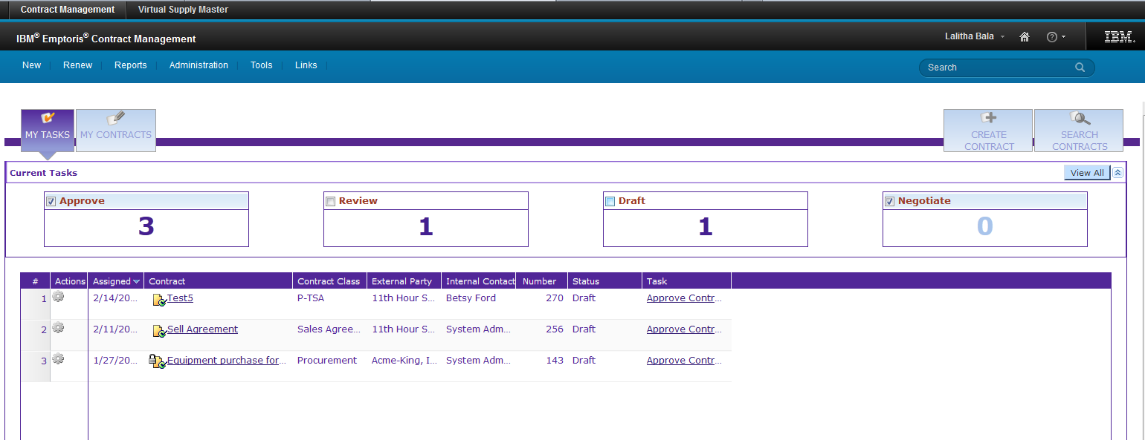
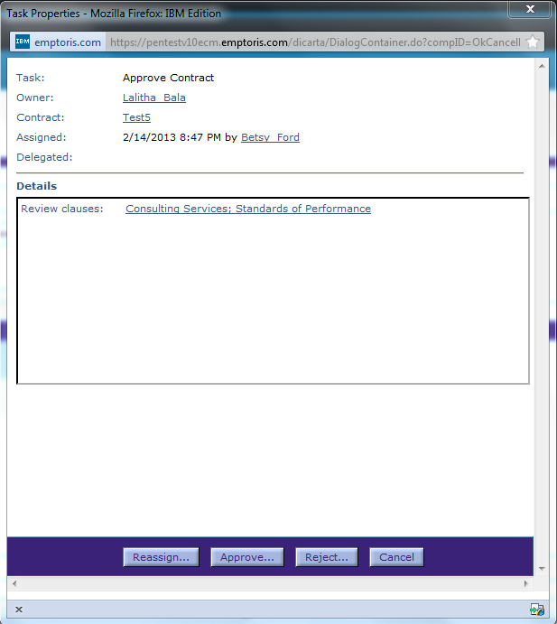
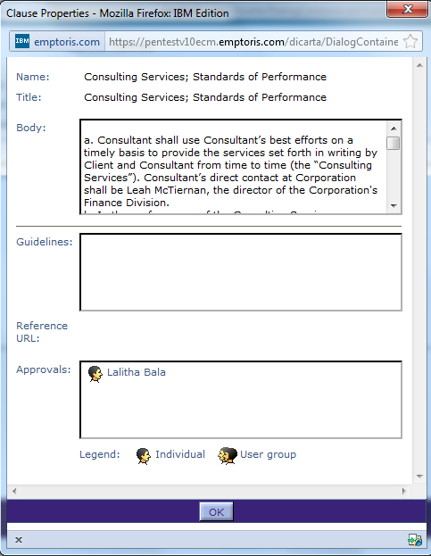
Option 2: Approver logs into the application - User clicks on “task” in the UI

Slide 8
Option 3 – PDA approval
User can click on this link on the
PDA and finish the task
In the email, contract summary and the actual contract can be attached. User can read the information and then click on the link to finish task

Slide 9
Approvals - Overview
Clause-level approvals
System always checks for this first
Contract-level approvals
Once clause-level approvals are done; system checks for contract-level approvals

Slide 10
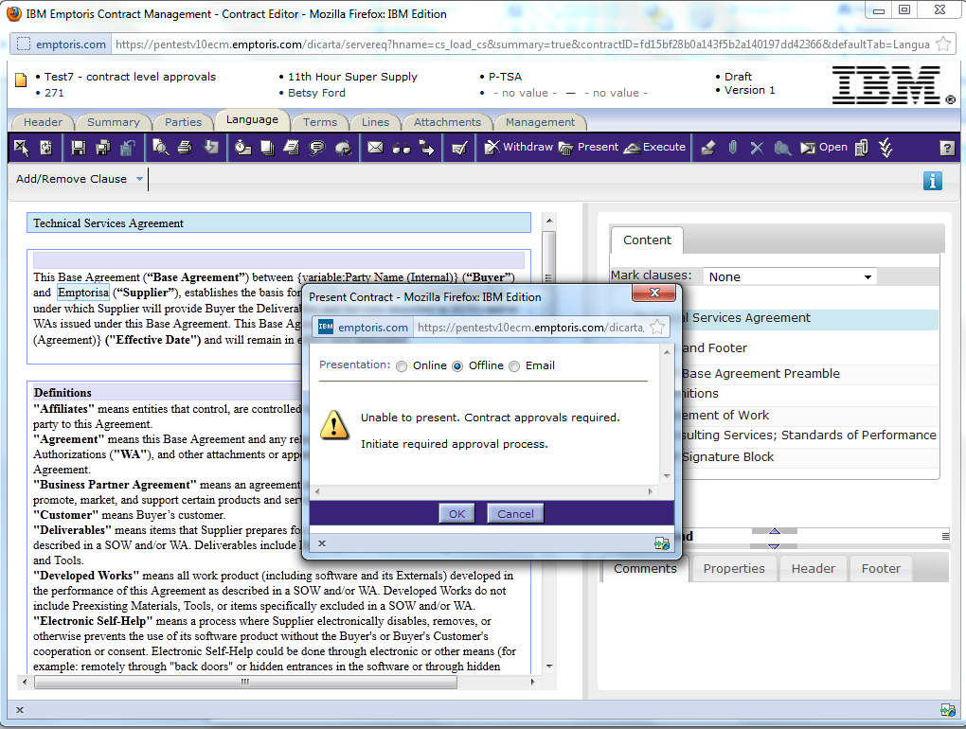
Initiating Contract-level Approvals User clicks on Present/Execute

Slide 11
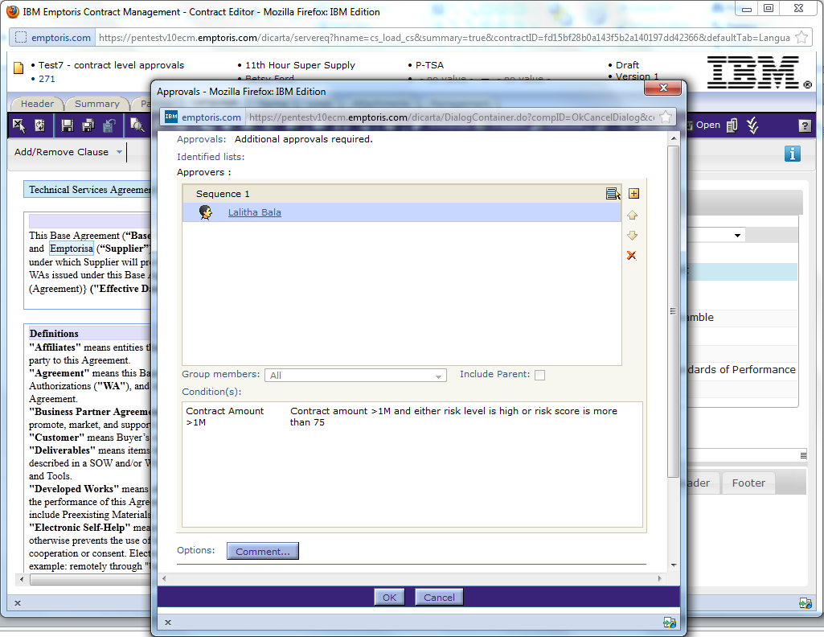
User Initiates Approvals
Initiator sees – who needs to approve
Initiator sees “Why”– Rule description that triggered approvals
Trigger can be a combination
This particular case the condition is:
Estimate Contract Total > 1M AND (Risk level = High OR Risk Score >75)

Slide 12
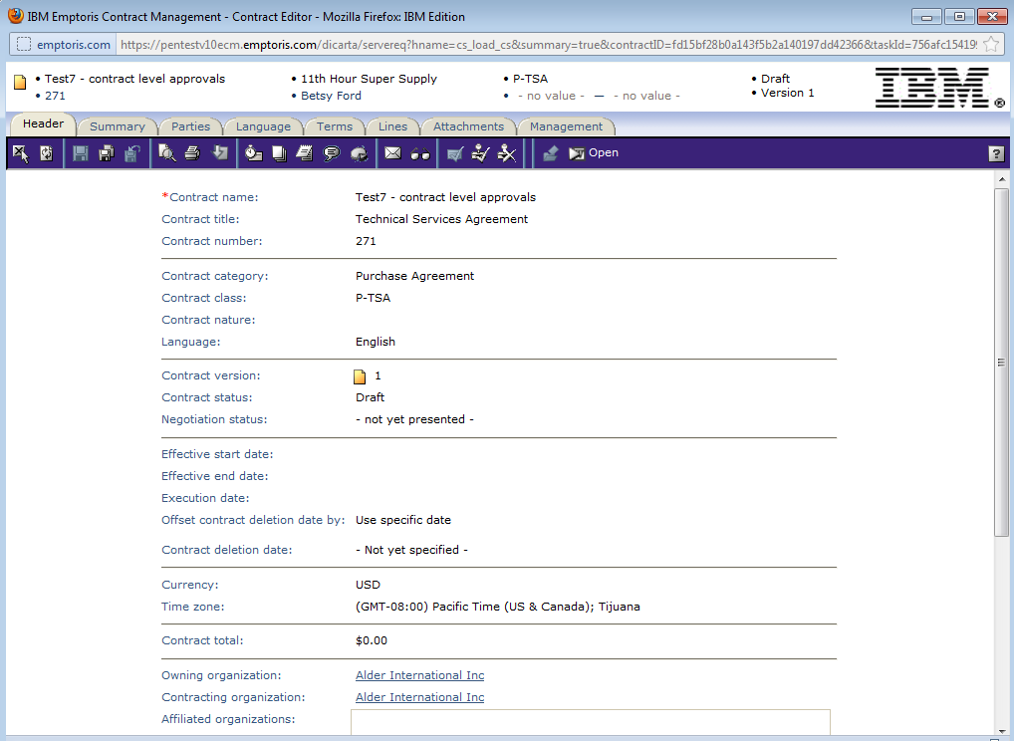
Approver – gets email; launches contract; and takes action
User is in essence approving the entire contract
Can include entire contract document and contract summary as attachments to the email

Slide 13
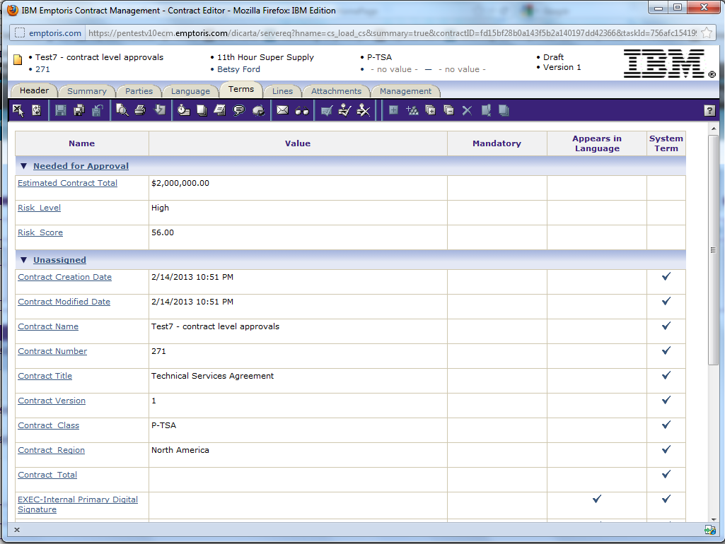
Terms tab – read terms; lines tab – read lines
Can group important terms together (grouping defined at contract template – is not based on rules configuration)
User is approving the contract, not specific terms

Slide 14
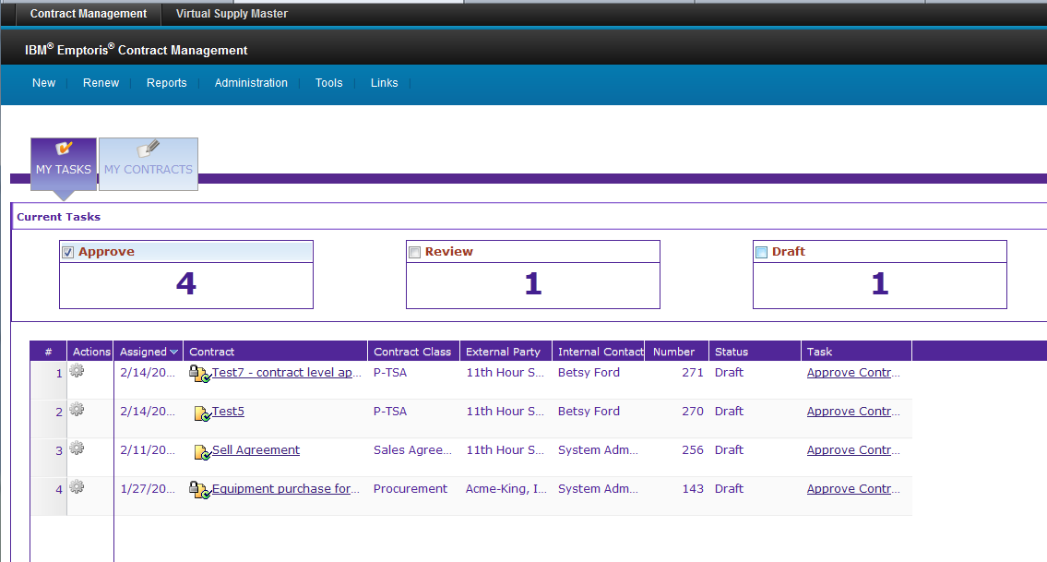
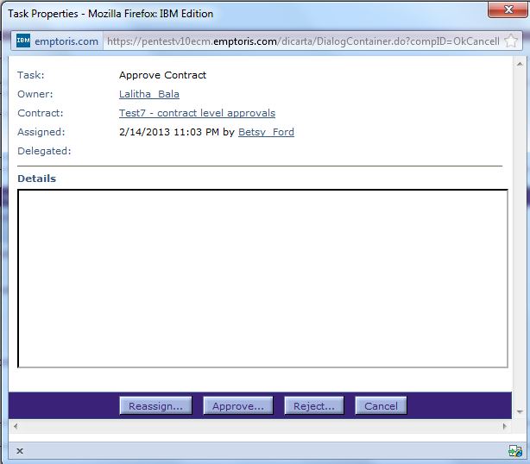
Option 2 – user logs in and completes task from home page

Slide 15
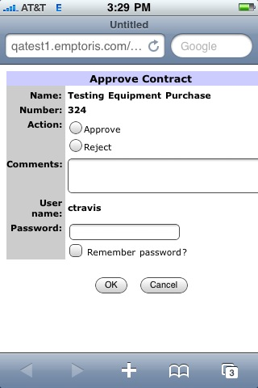
Option 3 – PDA approval
User gets
Can include entire contract document and contract summary as attachments to the email

Slide 16
Contract-Level Approvals – 2nd Step
Rule set – A grouping of rules
The definition of a rule set can be configured in the Approvals section in the UI
Example – this rule set applies to all contracts in NA; another rule set for all contracts in Europe etc
A rule set can have several rules
Terms, owning org, contracting org, contract origin
Rule set conditions evaluated at presentation/execution of execution of a contract
First rule set whose conditions are met drives approval chain
Example – if the contract is being presented belongs to North America, then rule set for North American contracts is triggered.
Each and every rule in the selected rule set is evaluated
All the rules where conditions from met are consolidated
Approvers from all the rules whose conditions are met added to the chain

Slide 17
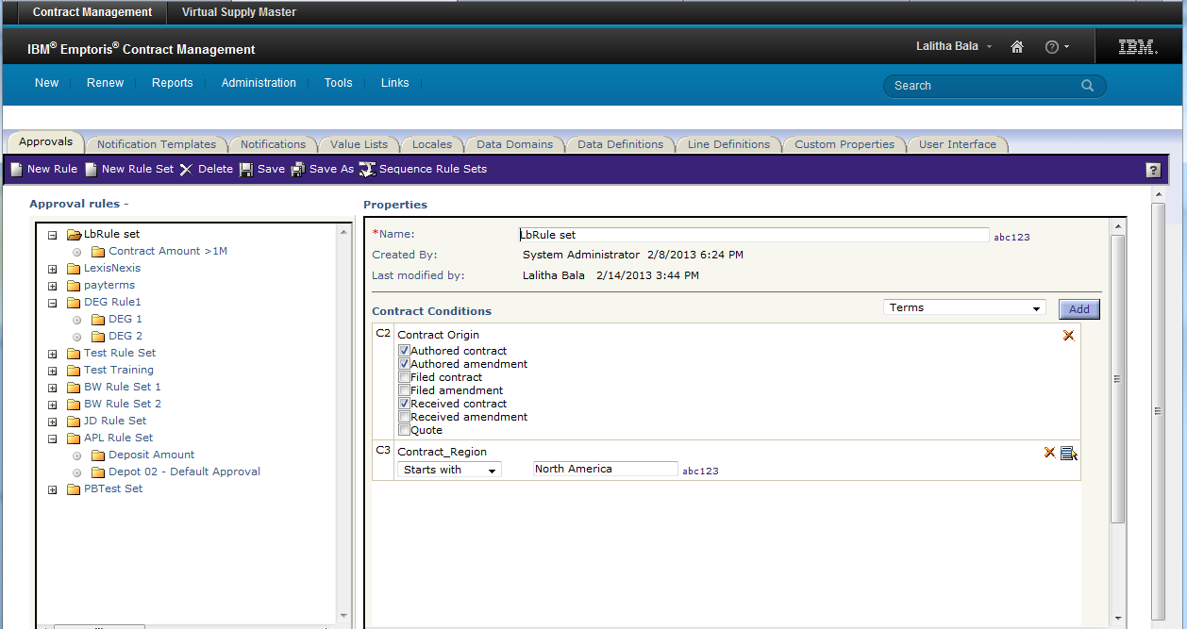
Rule Sets
Rules in a rule set
Conditions that trigger the rule set

Slide 18
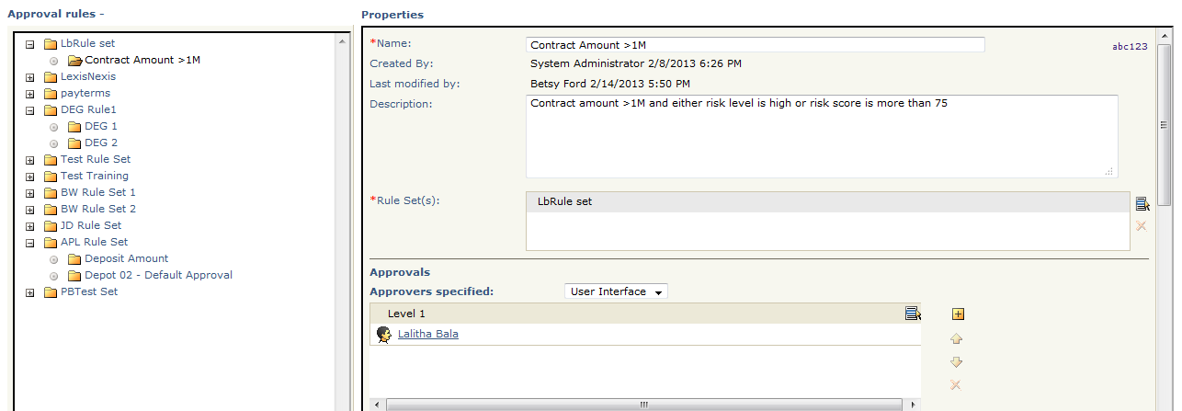
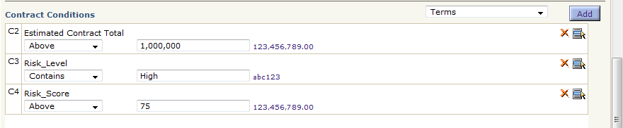
Rules Configuration
Rule Description
List of approvers – on a rule
Multiple conditions can trigger a rule
These conditions can be combined using AND/OR/ “(“, “)”

Slide 19
Approval Chain Generation
Approval chain created from multiple rules
Rule1
Level 1 – A1, A2 (in parallel)
Level 2 – A3
Level 3 – A4
Level 7 – A5
Rule 2
Level 1 – B1
Level 5 – B3, B4 (in parallel)
Level 7 – B5
Level 8 – B6, B7 (in parallel)
Sequence 1 – A1, A2, B1 (in parallel)
Sequence 2 – A3
Sequence 3 – A4
Sequence 4 – B3, B4 (in parallel)
Sequence 5 – A5, B5 (in parallel)
Sequence 6 – B6, B7 (in parallel)
System generates the sequence of approvers
Default approvers from template or contract are also added to the final chain
Notes:
Levels in the approval rule page – sequence in the approvals initiation page
Approvers at the same level are added to the same “Sequence” in the approval chain
There are no gaps in sequences – if there are gaps in levels – those are removed when sequences are generated.

